Slide 1
Day 2 – Session 1
Bologna Qualifications Framework

Slide 2
Agenda
1
2
3
4
5
6
7
8
The Qualifications framework
EFQ for EHEA
EFQ for LLL
National Qualifications Framework
The three cycles
ECTS
Mobility
The Diploma Supplement

Slide 3
«The Qualifications frameworks»
Qualifications frameworks are important instruments in achieving comparability and transparency within the EHEA and facilitating the movement of learners within, as well as between, higher education systems. They should also help HEIs to develop modules and study programmes based on learning outcomes and credits, and improve the recognition of qualifications as well as all forms of prior learning.
London Communiqué, May 2007

Slide 4
«The European Qualifications frameworks»
Framework for Qualifications of the European Higher Education Area (QF-EHEA)
European Qualifications Framework for Lifelong Learning of the EU (EQF-LLL).
The European Qualifications frameworks

Slide 5
EFQ for EHEA
Third cycle qualifications has not a fix number of ECTS credits
EFQ-EHEA
THREE MAIN CYCLES
IDENTIFIED AND DESCRIBED BY DUBLIN DESCRIPTORS
First cycle qualifications typically include 180 or 240 ECTS credits.
Second cycle qualifications 90 or 120 ECTS credits
Knowledge
Understanding
Judgments
Communication skills

Slide 6
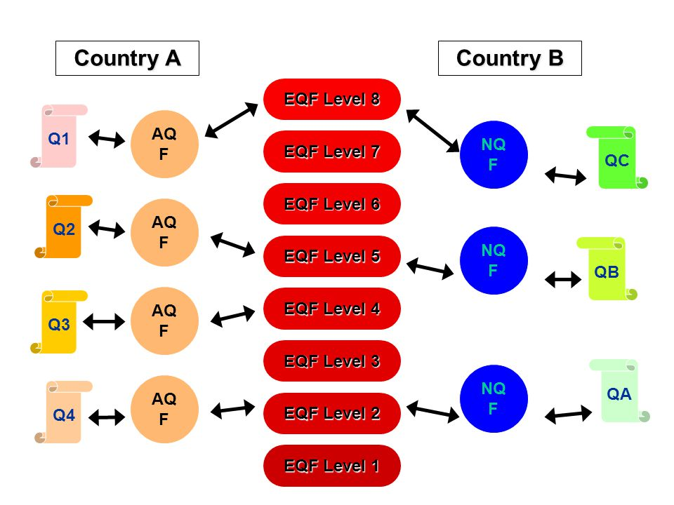
EFQ for LLL
The EQF-LLL describes ‘levels of qualification’ (without indicating any credit ranges) – to provide a common reference framework which assists in comparing the national qualifications systems, frameworks and their levels. It is based on eight levels.
As an instrument for the promotion of lifelong learning, the EQF encompasses general and adult education, vocational education and training as well as higher education.

Slide 7
EFQ for LLL
The eight levels cover the entire span of qualifications from those achieved at the end of compulsory education to those awarded at the highest level of academic and professional or vocational education and training.
Each level should in principle be attainable by way of a variety of education and career paths.
Learning outcomes are specified in three categories – as knowledge, skills and competence. This signals that qualifications– in different combinations – capture a broad scope of learning outcomes, including theoretical knowledge, practical and technical skills, and social competences where the ability to work with others will be crucial.

Slide 8
EFQ for LLL

Slide 9
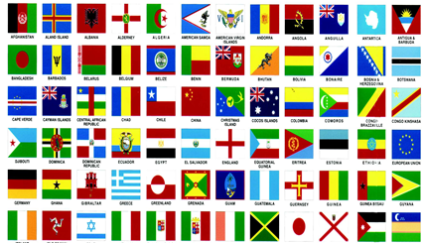
NQF
National education systems may include levels other than those included in the overarching frameworks as long as national frameworks are self-certified and referenced against the QF-EHEA and the EQF. For example, while the EQF comprises 8 levels, the number of levels in national frameworks currently ranges from 7 to 12. Therefore, the fact that short cycle qualifications are included in the QF-EHEA does not oblige
countries to include such
qualifications in their national
frameworks but it gives explicit
recognition to the fact that many
national frameworks do include
short cycle qualifications.

Slide 10
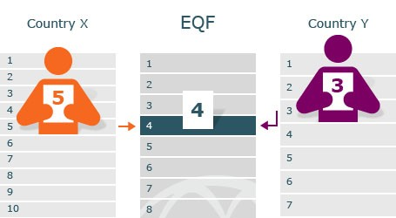
A Framework for Qualifications of the European Higher Education Area
The overarching Framework for Qualifications of the European Higher Education Area derives its distinctive purposes from the objectives expressed through the Bologna Process: international transparency, recognition, and mobility. International recognition of qualifications builds on transparency. The overarching Qualification Framework, provides a common understanding of the outcomes of a programme as represented by the qualification (diploma). This contrasts with a mere assertion of comparability. The overarching Qualification Framework greatly enhances the usefulness of qualifications across the EHEA.

Slide 11
A Framework for Qualifications of the European Higher Education Area - The three cycles
First cycle - Bachelor's level
This cycle typically include 180-240 ECTS credits
Qualifications that signify completion of the first cycle (e.g. Bachelor's degrees) are awarded to students who:
have demonstrated knowledge and understanding in a field of study that builds upon their general secondary education, and is typically at a level that, whilst supported by advanced textbooks, includes some aspects that will be informed by knowledge of the forefront of their field of study;
can apply their knowledge and understanding in a manner that indicates a professional approach to their work or vocation, and have competences typically demonstrated through devising and sustaining arguments and solving problems within their field of study;
have the ability to gather and interpret relevant data (usually within their field of study) to inform judgements that include reflection on relevant social, scientific or ethical issues;
can communicate information, ideas, problems and solutions to both specialist and non-specialist audiences;
have developed those learning skills that are necessary for them to continue to undertake further study with a high degree of autonomy.
The first cycle (e.g. Bachelor's degrees) of the Qualifications Framework of the European Higher Education Area refers to level 6 of the European Union's European Qualifications Framework.

Slide 12
A Framework for Qualifications of the European Higher Education Area - The three cycles
Second cycle - Master's level
This cycle typically include 90-120 ECTS credits, with a minimum of 60 credits at the level of the 2nd cycle
Qualifications that signify completion of the second cycle (e.g. Master's degrees) are awarded to students who:
have demonstrated knowledge and understanding that is founded upon and extends and/or enhances that typically associated with the first cycle, and that provides a basis or opportunity for originality in developing and/or applying ideas, often within a research context;
can apply their knowledge and understanding, and problem solving abilities in new or unfamiliar environments within broader (or multidisciplinary) contexts related to their field of study;
have the ability to integrate knowledge and handle complexity, and formulate judgements with incomplete or limited information, but that include reflecting on social and ethical responsibilities linked to the application of their knowledge and judgements;
can communicate their conclusions, and the knowledge and rationale underpinning these, to specialist and nonspecialist audiences clearly and unambiguously;
have the learning skills to allow them to continue to study in a manner that may be largely self-directed or autonomous.
The second cycle (e.g. Master's degrees) of the Qualifications Framework of the European Higher Education Area refers to level 7 of the European Union's European Qualifications Framework.

Slide 13
A Framework for Qualifications of the European Higher Education Area - The three cycles
Third cycle - PhD
A typical amount of credits is not prescribed for this cycle
Qualifications that signify completion of the third cycle are awarded to students who:
have demonstrated a systematic understanding of a field of study and mastery of the skills and methods of research associated with that field;
have demonstrated the ability to conceive, design, implement and adapt a substantial process of research with scholarly integrity;
have made a contribution through original research that extends the frontier of knowledge by developing a substantial body of work, some of which merits national or international refereed publication;
are capable of critical analysis, evaluation and synthesis of new and complex ideas;
can communicate with their peers, the larger scholarly community and with society in general about their areas of expertise;
can be expected to be able to promote, within academic and professional contexts, technological, social or cultural advancement in a knowledge based society.
The third cycle (e.g. PhD or Doctoral degrees) of the Qualifications Framework of the European Higher Education Area refers to level 8 of the European Union's European Qualifications Framework.

Slide 14
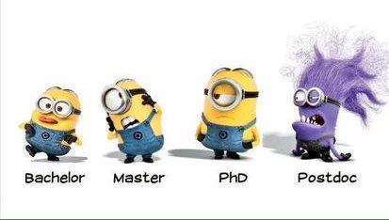
The three cycles
In general terms, the qualifications corresponding to each cycle guarantee access to the next cycle, taking into account the internal regulations established by the various legislations of the member countries. In a single cycle various types of courses may be included with differing lengths, different educational objectives and may be characterized by a leaning more towards the academic or towards the professional.

Slide 15
MOBILITY:
It brings openness to higher education systems.
It enables countries to learn from each other’s best practices and promotes international cooperation.
It encourages innovation in both teaching and learning and it tailors learning, training and qualifications more closely to individuals’ needs.
It’s closely linked to the attractiveness of institutions
It’s a major component of internationalisation.
This is why Ministers in 2012 fixed a
target for mobility for the EHEA,
where, by 2020, at least 20% of
those graduating in the EHEA
should have had a study or
training period abroad.

Slide 16
A Framework for Qualifications of the European Higher Education Area - ECTS
The European Credit Transfer and Accumulation System (ECTS) is a tool which helps to design, describe and deliver study programmes and award Higher Education qualifications. The use of ECTS, in conjunction with outcomes-based qualifications frameworks, makes study programmes and qualifications more transparent and facilitates the recognition of qualifications.

Slide 17
A Framework for Qualifications of the European Higher Education Area - ECTS
ECTS was designed to facilitate learning mobility between institutions for short-term study periods (‘credit mobility’). As this Guide makes clear, ECTS has developed and been adopted for purposes of credit accumulation but it still plays a vital role in student mobility – facilitating the transfer and recognition of the achievements of the mobile student.
In ECTS, the following supporting documents help facilitate credit recognition for the purpose of mobility:
These documents provide information on the learning outcomes achieved, on which the qualification-awarding institution can make decisions on credit recognition and transfer.
Learning Agreement
Transcript of Records
Traineeship Certificate
Course Catalogue

Slide 18
Before the credit mobility period
In order to facilitate the organisation of credit mobility and its recognition, the three parties involved – the student, the sending institution and the receiving institution or organisation/enterprise – should agree on the programme abroad. They should formalise this in a Learning Agreement, to be signed by the three parties before the start of the mobility period.
The Learning Agreement is intended to
give the student the confirmation that
the credits he/she successfully achieves
during the mobility period will be
recognised.

Slide 19
Learning Agreement – Univaq case BEFORE THE MOBILITY

Slide 20
Learning Agreement – Univaq case BEFORE THE MOBILITY

Slide 21
Learning Agreement – Univaq case BEFORE THE MOBILITY

Slide 22
Learning Agreement – Univaq case DURING THE MOBILITY

Slide 23
After the credit mobility period
The receiving institution provides the sending institution and the student with a Transcript of Records within a reasonably short period of time (stipulated between the two institutions) after proclamation of the student’s results at the receiving institution.
Upon successful completion of the set of educational components included in the Learning Agreement and confirmed by the Transcript of Records sent by the receiving institution, the sending institution should recognise fully the agreed number of ECTS credits, transfer them into the student’s programme and use them to satisfy the qualification requirements. The sending institution should specify clearly how the educational components taken abroad have been integrated into the home degree programme.
All this information should be recorded
in a Transcript of Record (or equivalent
document/database) made available to
the student.

Slide 24
Certificate of attendance AFTER THE MOBILITY

Slide 25
Transcript of Records – Univaq case AFTER THE MOBILITY

Slide 26
Study recognition procedure – Univaq case AFTER THE MOBILITY

Slide 27
Diploma Supplement
The Diploma Supplement is designed to provide graduates with a transparent record of their achievements. Therefore, the educational components successfully completed abroad will be included in the Transcript of Records attached to the Diploma Supplement with their original titles (and their translation into the language(s) in which the Diploma Supplement is issued), the indication of the institution where they have been taken and the credits and grades awarded.
In the case of work placements abroad, the transfer of credits will be documented in the Work Placement Certificate and the Diploma Supplement or Europass Mobility Document.

Slide 28
Diploma Supplement
The Diploma Supplement (DS) is a document accompanying a higher education diploma, providing a standardised description of the nature, level, context, content and status of the studies completed by its holder. It is produced by the higher education institutions according to standards agreed by the European Commission, the Council of Europe and UNESCO.
The supplement is designed as an aid to help (but not guarantee) recognition – it is not a CV or a substitute for the original qualification. It has the following eight sections of information:
the holder of the qualification
the qualification
its level and function
the contents and results gained
certification of the supplement
details of the national higher education system concerned
any additional relevant information.
Graduates in all the countries taking part in the Bologna Process have
the right to receive the Diploma Supplement automatically, free and in
a major European language.

Slide 29
Diploma Supplement: What are the benefits?
For students:
a qualification that is more readable and easily comparable abroad;
a precise description of their academic career and the competencies acquired during their studies;
easier access to opportunities for work or further studies abroad.
For higher education institutions:
more transparent qualifications;
continued national/institutional autonomy within a common framework accepted throughout Europe;
informed judgements about qualifications that can be understood in other educational contexts;
greater visibility of the institution abroad;
enhanced employment prospects for their graduates, both at home and abroad;
time savings – by answering many of the questions commonly asked of institutions about the content and portability of their qualifications.

Slide 30
Questions
Thank you for your attention

