Slide 1
Day 5 – Session 3
Training structure

Slide 2
Agenda
Topic 1: Structure for student mobility training.
Topic 2: Alignment of training with institutional policy
Topic 3: Training integration

Slide 3
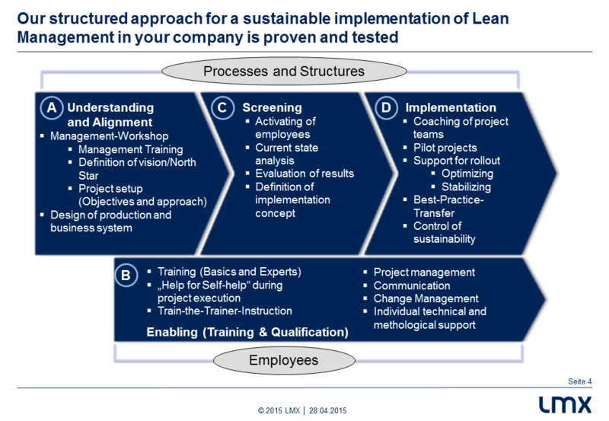
Topic 1: Structure for student mobility training
Training may be based on:
Top-down variation with project approach
Bottom-up variation with transformation approach
Source: http://www.lmx.eu/en/solutions-and-results/pproach

Slide 4
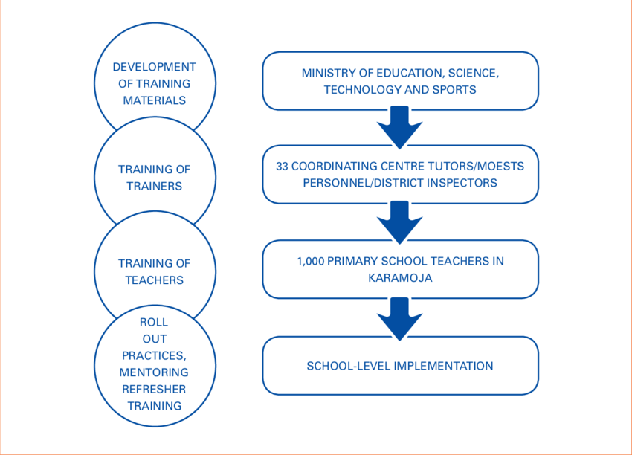
Layered structure for student mobility training
Replicating the sequence of training tasks
Cascading training focus
Mapping training objectives to different institutional structures
Source: https://www.researchgate.net/figure/305634932_fig1_FIGURE-1-UNICEF-and-MoESTS-training-structure

Slide 5
Your institution’s training structure
Policy
Process
How will senior management support be provided?
Who will line manage trainers?
Which units will be in charge of training?
What reporting mechanisms will be in place?
How will training be evaluated and by whom?
Who will be the trainers?
Which unit will they belong to?
What key performance indicators will be used?
How training delivery be organised?
What monitoring mechanism will be used?
How will any transformations be implemented?
Source: http://www.lmx.eu/en/solutions-and-results/pproach

Slide 6
Topic 2: Alignment of training with institutional policy
The mapping process
Institutional strategy ----- > Training strategy
Relevant policies ----- > Student mobility policy
Key performance indicators ----- > Training objectives
Procedures ----- > Training operational plan
Evaluation mechanisms ----- > Monitoring mechanisms
Reporting process ----- > Reflection on training success criteria
Shaping future plans ----- > Adjustments to training scope

Slide 7
Reflecting on institutional policies
Consider which policies would have an impact on such training:
Policy | Description | Relevance
Staff development | Identifying opportunities for professional development | Affects appraisals and staff development progress
e.g. … | e.g. … | e.g. …

Slide 8
Topic 3: Training integration
Create a leadership development plan for student mobility with key stakeholders
Identify the key champions and institution-level executive support
Plan human resources for training
Select trainers
Identify training success criteria
Provide incentives and rewards
Introduce recognition mechanisms for trainees
Run, monitor and support training
Source: https://image.slidesharecdn.com/mr-p-dwarakanath-090914035036-phpapp02/95/competency-management-in-organizations-17-728.jpg?cb=1252900266

Slide 9
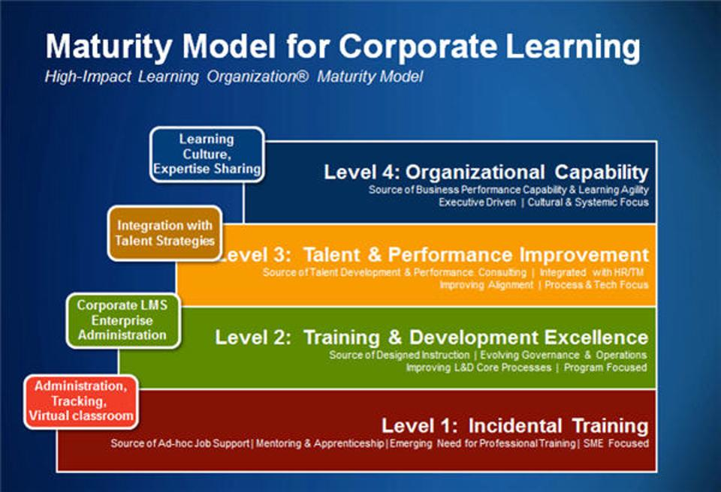
Assess your institution’s maturity
Understand the concept of corporate learning maturity
Determine institution’s maturity
Identify gaps
Plan improvements
Reflect on impact it has for the student mobility training
Source: https://blogs-images.forbes.com/joshbersin/files/2013/03/hilomm.jpg?width=960

Slide 10
Train-storming
Design a structure for student mobility training at your institution.
Identify institutional policies that are likely to be affected by the integration of student mobility in your institution.
Identify departments and roles that are likely to be involved by the integration of student mobility in your institution.

Slide 11
Questions
?

