Slide 1
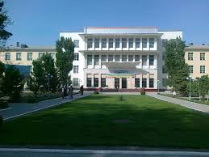
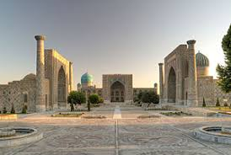
Samarkand Agricultural Institute
City: Samarkand
Country: Uzbekistan

Slide 2
Agenda
Credit system used at the institution
Alignment (or lack of) with the Bologna Process
Use (or lack of) ECTS
Administration structure supporting student mobility
Student mobility process
Credit transfer process
Grade conversion process

Slide 3
Credit system used at the institution
The Bologna Process in Uzbekistan
Legislation on ECTS | In Samarkand agricultural institute using 100 point grading system for each subject, which include current assessment - 30 points, interim assessment - 40 points and final assessment - 30 point. Assessments can be done in writing, testing, oral methods. The student must score at least 55 points. On the basis of the assessment results a decision is made about the transfer of successful students to the next year of the educational programme. It is impossible to be transferred to the next year if the requirements of the curriculum are not met by the students.

Slide 4
Alignment with the Bologna Process
Student workload/duration for the most common Bologna programmes
Bachelor programmes -4 years | Not compliant with Bologna | Master programmes-2 years | Not compliant with Bologna | Postgra-duate educa-tion- PhD programmes-3 years | Not compliant with Bologna

Slide 5
Use of ECTS
We are not using ECTS.

Slide 6
Administration structure supporting student mobility
International relation’s office
Council of institute
Related Faculties
Related Departments

Slide 7
Student mobility process
The fostering of international co-operation has been defined as one of the tools for achieving the objectives of HE modernisation.
International cooperation is being achieved in the following ways (based on data supplied by MHSSE):
• establishment of joint higher education institutions;
• involvement of foreign lecturers and scientists in the teaching process at Uzbek HEIs;
• support for incoming and outgoing student mobility;
• support for the organisation of joint research work;
• organisation of international conferences on current problems in higher education, innovative technologies, resources and energy saving;
• attracting foreign investment.

Slide 8
Student mobility process
The first generation of Credit Mobility projects has started in 2015 with 67 partnerships of 30 Uzbek HEIs and 28 European universities (13 EU Member States) which envisage in total 253 mobilities, including 183 in-coming (UZ-EU) flows and 70 out-going (EU-UZ). 107 Uzbek students will benefit of scholarships to Europe and 12 Doctoral students will come to Uzbekistan. Also 76 Uzbek staff members of HEIs will benefit of training in Europe and 58 academic staff of EU universities will teach and share their knowledge and experience during mobility to Uzbekistan. Selection data available on the 1st round of 2015 Call for ICM.

Slide 9
Credit transfer process
Currently, the credit transfer processes is at the development stage. Although, exchange students are graded at EU universities, this assessment is not considered as a part of curriculum at Uzbek HEI`s.

Slide 10
Grade conversion process
During the academic year there are several phases of assessment undertaken for Bachelor and Master students regarding each academic subject taught during the semester. A rating system (minimum - 56 points, maximum - 100 points) was introduced in 1999 for all types of HEIs in Uzbekistan. The system requires a separate allocation of academic hours for student independent learning and the assessment of the students’ knowledge at the end of each semester. The following marking scheme is applied:
86-100 – excellent (5);
71-85 - good (4);
56-70 – satisfactory (3);
less than 55 - unsatisfactory.

