Slide 1
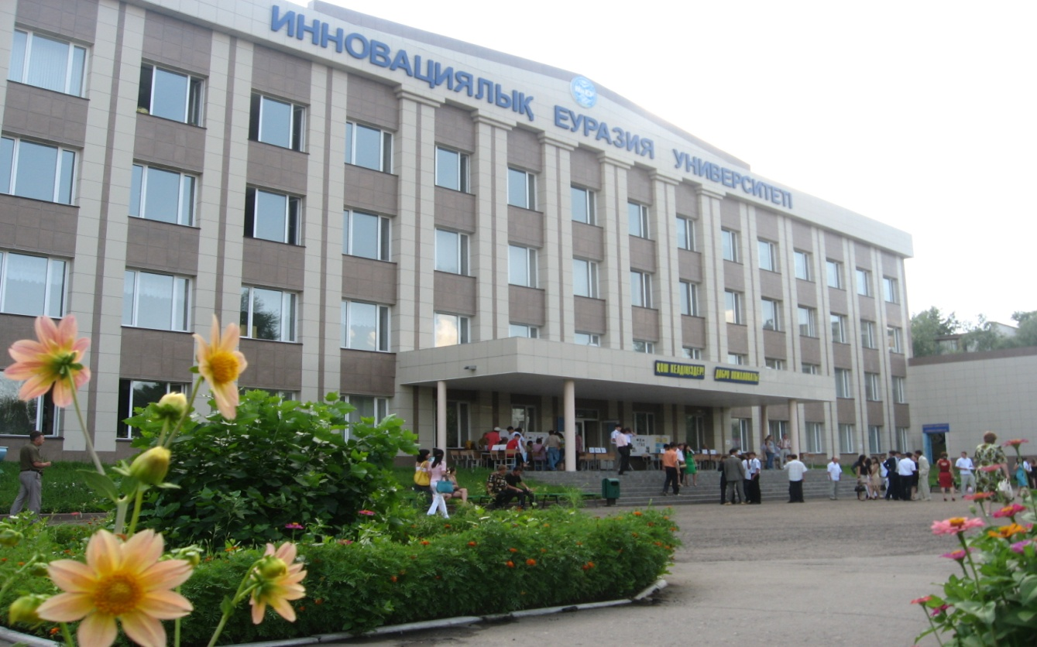
Innovative University of Eurasia Pavlodar Kazakhstan

Slide 2
Innovative University of Eurasia
2
Agenda
Credit system used at the institution
Alignment (or lack of) with the Bologna Process
Use (or lack of) ECTS
Administration structure supporting student mobility
Student mobility process
Credit transfer process
Grade conversion process

Slide 3
Credit system used at the institution
3
For the international recognition of educational training programs, mobility of students and teachers and improve the quality of education and continuity of education at all levels in educational institutions the universities of the Republic of Kazakhstan use unified credit technology of training.

Slide 4
Credit system used at the institution
4
Academic mobility is regulated by the following documents in the Republic of Kazakhstan:
The Concept of Academic Mobility of Students of Higher Educational Institutions
Law on Education of the Republic of Kazakhstan
The State Programme of Education Development in the Republic of Kazakhstan for 2011-2020
The Rules on Organisation of Educational Process on Credit Technology of Education
Regulations for studying abroad, including the academic mobility
The strategy of academic mobility in the Republic of Kazakhstan

Slide 5
Alignment (or lack of) with the Bologna Process
5
The University shall follow the procedures of the Bologna process, offering students bachelor's, master's and doctoral programs of academic mobility, study abroad, international internships, allowing them to enrich their knowledge and practical skills, language and social competence in a global dimension.

Slide 6
Use (or lack of) ECTS
6
Kazakhstan 1 credit is 45 academic hours
1 academic hour is 50 minutes
Bachelor
The main criterion of completion of the educational process is the development by the student of at least 129 credits of theoretical training and at least 6 credits of practices, at least 2 credits the preparation, writing and protection of diploma work (project) and at least 1 credit for training and passed the state exam on the specialty
Master's degree
Scientific and pedagogical magistracy not less than 51 credit, 1 year master's degree not less than 26 credits, 1.5 years graduate - not less than 38 credits

Slide 7
Administration structure supporting student mobility
7
Mobility of students is carried out on the levels:
The office of international relations (Vice-rector for science and innovation)
2.The Dean in each faculty (students, undergraduates and doctoral students) with the registration office
3. Coordinators from the departments

Slide 8
Student mobility process
8
The University system of organization of academic mobility open to all
Steps:
Negotiations the office of international relations with universities partners
The determination of filing deadlines
A statement of the student leaving on the mobility programme
Preparing the learning agreement for mobility, the order of the Dean, the transcript
Confirmation of arrival for mobility
Training mobility
After mobility-confirmation of attendance, transcript

Slide 9
Credit transfer process
9
RULES ON ORGANISATION OF EDUCATIONAL PROCESS ON CREDIT TECHNOLOGY OF EDUCATION
SECTION 4. KAZAKHSTAN CREDIT TRANSFER SYSTEM BASED ON ECTS
68. For the provision of academic mobility of students and recognition of educational programmes in the European educational space it is necessary to transfer Kazakhstan credits to ECTS credits.
74. Transfer of credits ECTS to credits of the Republic of Kazakhstan is carried out by dividing the ECTS credits in the conversion factor depending on density 1 ECTS credit for each discipline in the range of 1.5 to 1.8.
SECTION 5. ACADEMIC MOBILITY IN THE MODEL OF KAZAKHSTAN CREDIT TRANSFER BASED ON ECTS
81. University develops and approves the procedure of credit transfer based on ECTS, which is the main document on the use of ECTS in university
93. The final document confirming student mobility programme is a transcript.

Slide 10
Grade conversion process
10
Deputy Dean of each faculty with the registration office is responsible for the recognition of period of studies as in your University and in other universities of Kazakhstan and abroad, on the basis of the transcript of a student, obtained after the training on academic mobility program

Slide 11
11
Thank you for your attention!

