Slide 1
Baku Engineering University
Nargiz Nahmatova
27.11.2017

Slide 2
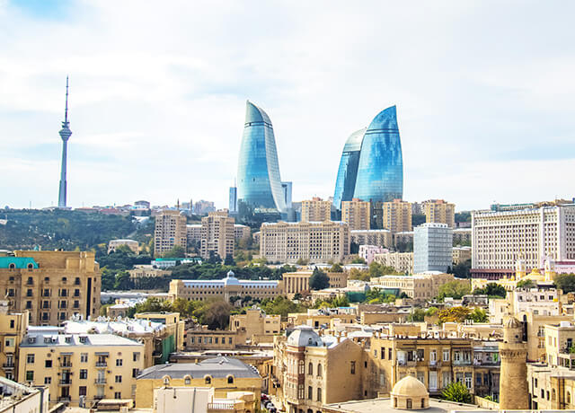
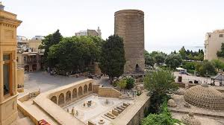
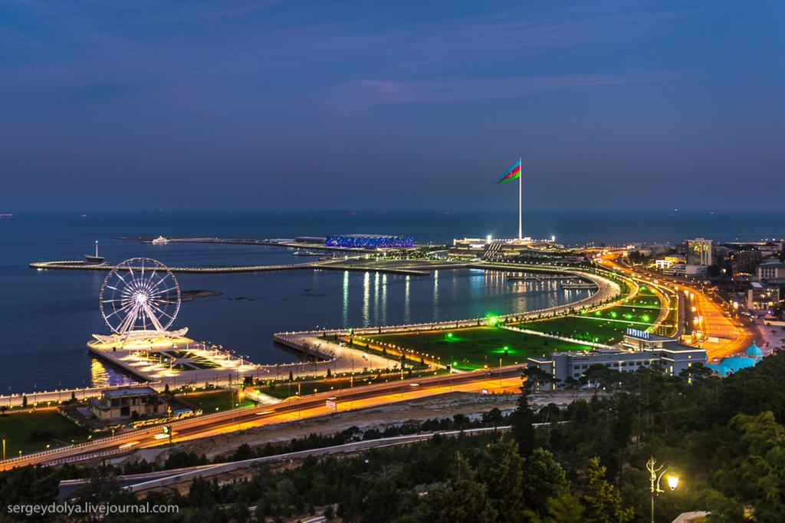
Baku Engineering University

Slide 3
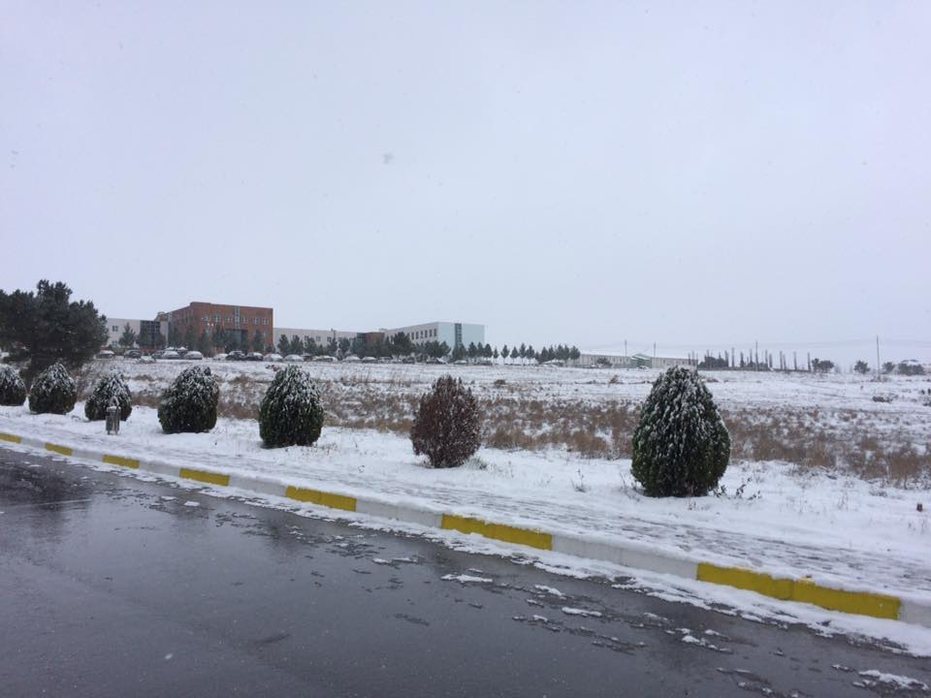
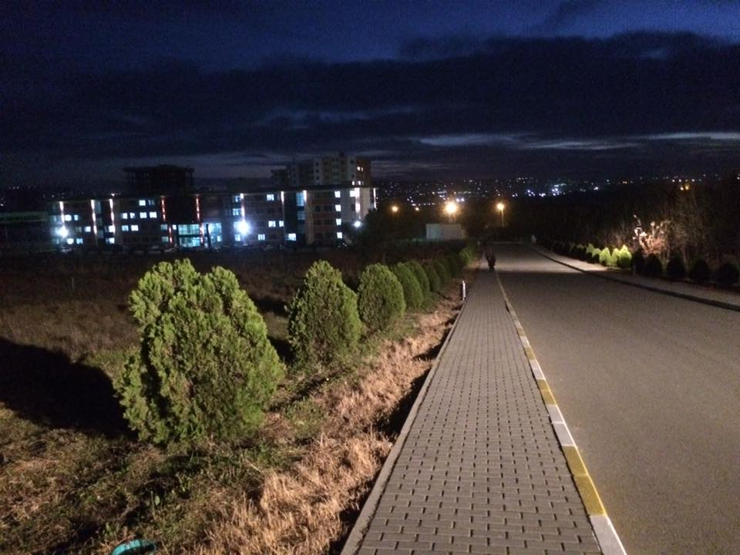
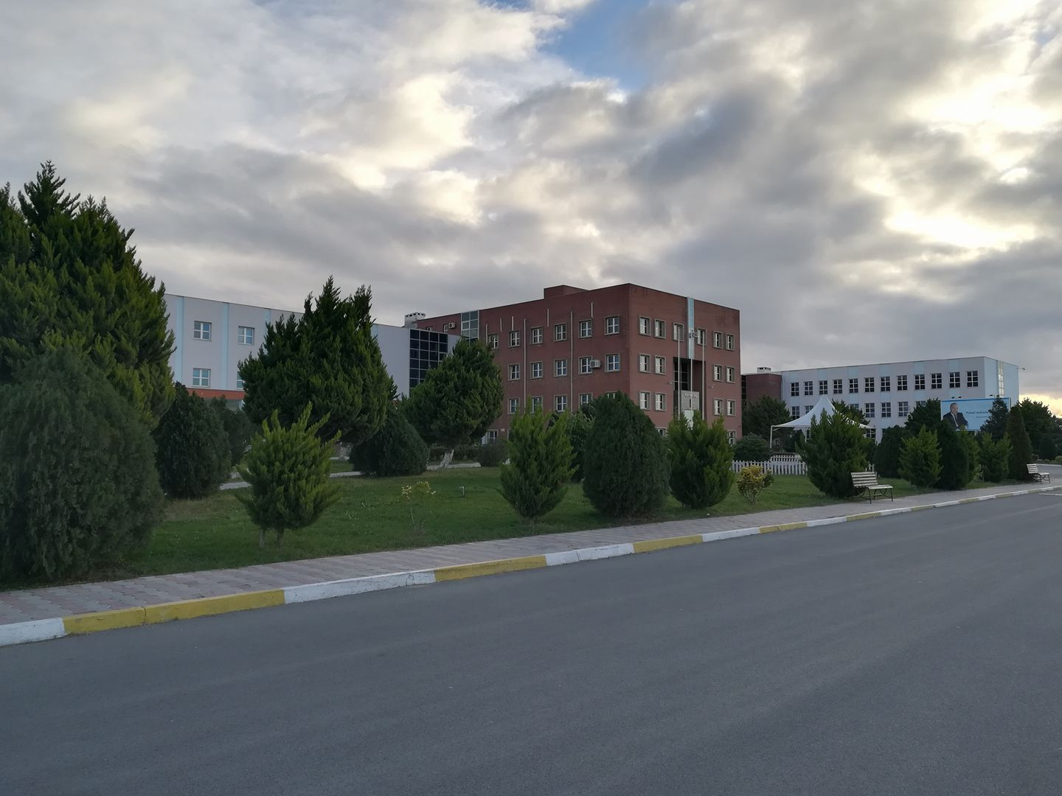
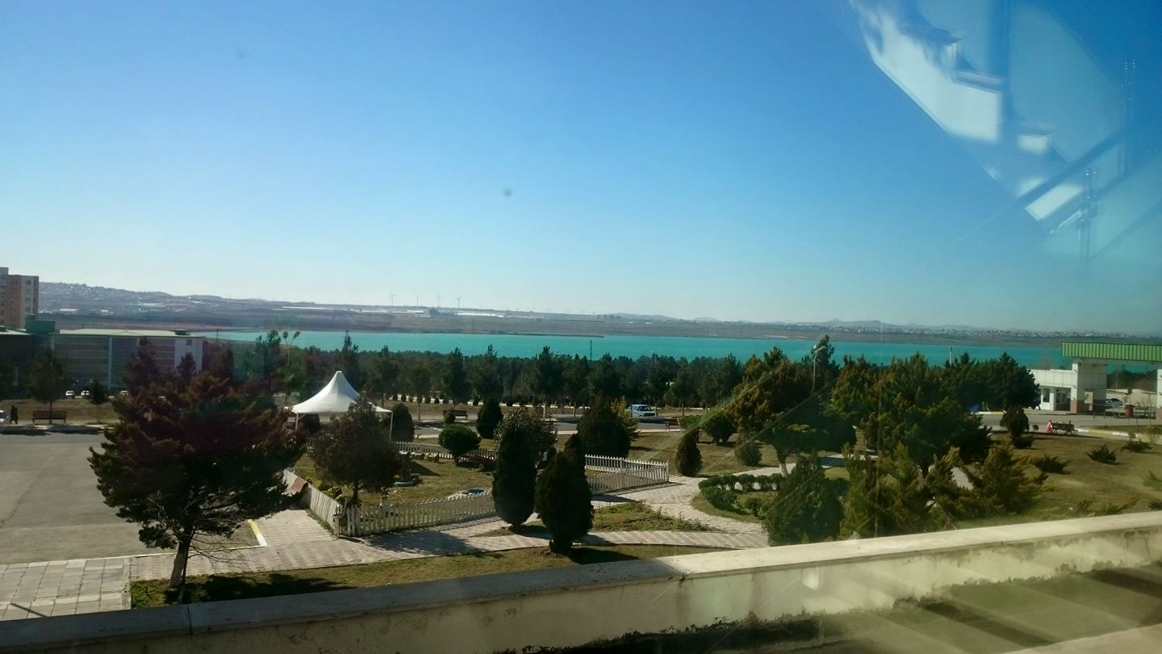
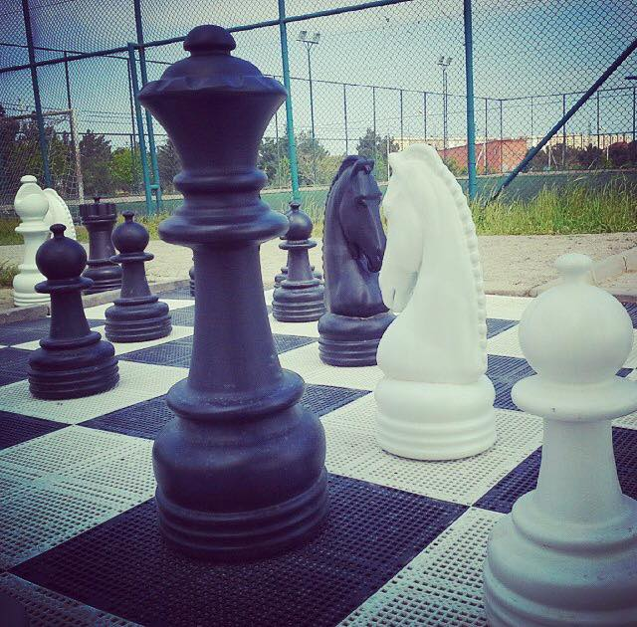
Baku Engineering University - Established in 2017 - Erasmus + (8-10 universities ) - Mevlana Exchange University - bilateral relations – 20 universities

Slide 4
Agenda
General Information
Credit system used at the institution
Alignment (or lack of) with the Bologna Process
Use (or lack of) ECTS
Administration structure supporting student mobility
Student mobility process
Credit transfer process
Grade conversion process

Slide 5
2. Credit system used at the institution
ECTS – is implemented by governmental law by Ministry of Education of AR.
Baku Engineering University
starting from 2017 University integrated to Bologna Process
Higher education in BEU includes 3 levels:
1st Cycle – Bachelor
2nd Cycle – Master
3rd Cycle – Doctoral (PhD)
BEU uses the procedures of the Bologna process for the students at Bachelor’s and Master’s levels.
3-rd cycle (PhD), but so far ECTS is not adopted yet
Notes:
Ects le elaqedar qanunvericilik

Slide 6
3. Alignment (or lack of) with the Bologna Process
Azerbaijan joined Bologna Process in 2005 at Bergen Summit
The state standard and program on Higher Education
Rules, regulations, executive orders
Notes:
was accepted as a pilot university for the introduction of the Bologna credit education. However, Bologna Qualifications Framework has been fully launched in our institution in 2015
Three circled system

Slide 7
4. Credit system used at the institution
In BSc Programs
Each student has to get 240 ECTS
Each semester – 30 ECTS – for a year = 60 ECTS
~ 80 % mandatory disciplines and 20 % elective disciplines
In MSc Programs
Each student has to get 120 ECTS
Each semester – 30 ECTS
In both of programs is required 75% attendance in the each course.

Slide 8
5. Administration structure supporting student mobility
International Relations office (vice dean for international relations)
Faculty Level
Council of department – vice head of department on education/exchange programs
Academic advisor each class
Student Affairs Department
Notes:
Office of Foreign Relations is responsible to manage and organize student mobility.
Respective faculty is responsible to assist a student to prepare the learning agreement

Slide 9
6. Student mobility process
1. Announcement to students
By website
By meetings
By class advisers
2. Applying online to International relations office
Office of International Relations sets the eligibility and mobility (e.i. draft of learning agreement) requirements agreed with the host university
3. Evaluating process
Office of Foreign Relations
evaluates applications based on criteria
Notes:
Calling for applications

Slide 10
6. Student mobility process
4. Decision making process
Based on ranking, top applicants are selected to nominate at host university.
Host university selects the final candidates for mobility.
5. Student mobility period
Office of IR, representative of department and student collaborate in the process of preparation leaning agreement
After mobility starts, changes could be made in learning agreements. All changes should be agreed with home and host universities
ECTS recognition is confirmed in advance between a student and respective faculty to avoid any misunderstanding after student mobility
6. Evaluating process at the end of mobility
Credit recognition
Notes:
If a student pass the course which are not included in his/her program, credits are recognized in the framework of free credits

Slide 11
7. Credit transfer process
Standards for each field (240 ECTS):
180 ECTS for subject area courses
30 ECTS for non-subject area courses
13 ECTS for foreign language
30 ECTS internship and thesis work
Notes:
- Erasmus + (8-10 universities )

Slide 12
7. Credit transfer process
Duration of BSc Program – 4 years
7 semesters
15 weeks - lectures, labs, etc.
5 weeks – exams
8-th semester
14 weeks – internship - 21 credits
6 weeks – Thesis- 9 credits

Slide 13
7. Credit transfer process
Duration of MSc Program – 2 years BEFORE 2017 September
3 Semesters for lectures, labs, etc.
Each semester – 15 weeks
5 weeks – exams
1 Semester for Internship and MSc Thesis
Internship – 4 weeks
Duration of MSc Program – 2 years AFTER 2017 September
First and Second semester 15 weeks
Third and Fourth semesters
4 + 4 weeks for practical and academic internship
12 weeks thesis writing

Slide 14
8. Grade conversion process
Department
Student Affairs
BEU GRADES
100-91 | A | EXCELLENT
90-81 | B | VERY GOOD
80-71 | C | GOOD
70-61 | D | SATISFACTORY
60-51 | E | SUFFICIENT
50< | F | FAILED
Notes:
IN ONE SEMESTER STUDENT OBTAIN CHANCE FOR 2 MAKE UP EXAM ACCORDING TO EDUCATION LAW

Slide 15
Thank you for your attention!
Sagh olun!
beu.edu.az
nnemetova@beu.edu.az
rsuleymanli@beu.edu.az

