Slide 1
Baku Engineering University
City: Khirdalan/Baku
Country: Azerbaijan
www.beu.edu.az

Slide 2
Agenda
Credit system used at the institution
Alignment (or lack of) with the Bologna Process
Use (or lack of) ECTS
Administration structure supporting student mobility
Student mobility process
Credit transfer process
Grade conversion process

Slide 3
Credit system used at the institution
In Azerbaijan the ECTS system has been implemented by the governmental law since 2005 (Ministry of Education).
BEU uses the procedures of the Bologna process for the students at Bachelor’s and Master’s levels.
We have 3`rd cycle (PhD), but so far ECTS is not adopted for it

Slide 4
Use of ECTS
In BSc Programs
Each student has to get 240 ECTS
Each semester – 30 ECTS
In MSc Programs
Each student has to get 120 ECTS
Each semester – 30 ECTS
In both of programs is required 75% attendance in the each course.

Slide 5
Alignment (or lack of) with the Bologna Process
Starting from 2016 University integrated to Bologna Process.

Slide 6
Administration structure supporting student mobility
International Relations office
Academic Advisor of departments
Student Affairs Department

Slide 7
Student mobility process
Applying online to International relations office
Evaluating process
Decision process
Student mobility period
Evaluating process at the end of mobility

Slide 8
Credit transfer process
We have state standards for each field (240 ECTS):
180 ECTS for subject area courses
30 ECTS for non-subject area courses
13 ECTS for foreign language
30 ECTS iinternship and thesis work
*1 ECTS is equal to 30 hours

Slide 9
Duration of BSc Program – 4 years
8 semesters
15 weeks - lectures, labs, etc.
5 weeks – exams
14 weeks – internship
6 weeks - Thesis

Slide 10
Duration of MSc Program – 2 years
3 Semesters for lectures, labs, etc.
Each semester – 15 weeks
5 weeks – exams
1 Semester for Internship and MSc Thesis
Internship – 4 weeks

Slide 11
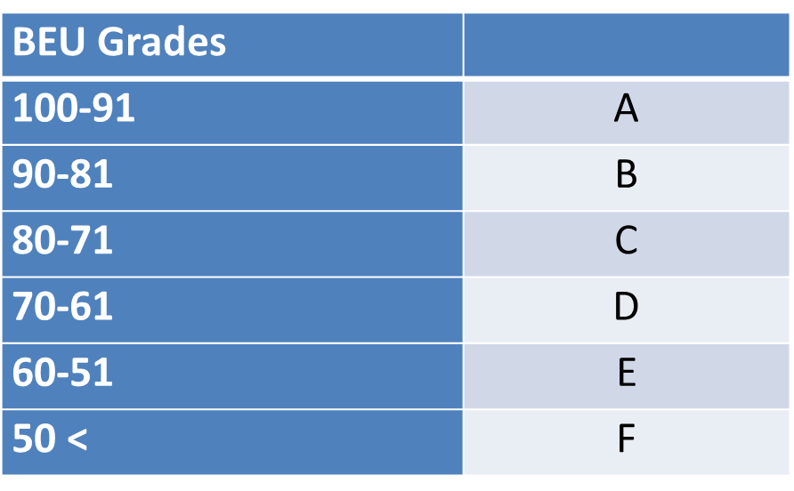
Grade conversion process
Alphabetical System

Slide 12
Thank you for your attention!

