Slide 1
Middlesex University
City: London
Country: United Kingdom

Slide 2
Agenda
Credit system used at the institution
Alignment (or lack of) with the Bologna Process
Use (or lack of) ECTS
Administration structure supporting student mobility
Student mobility process
Credit transfer process
Grade conversion process

Slide 3
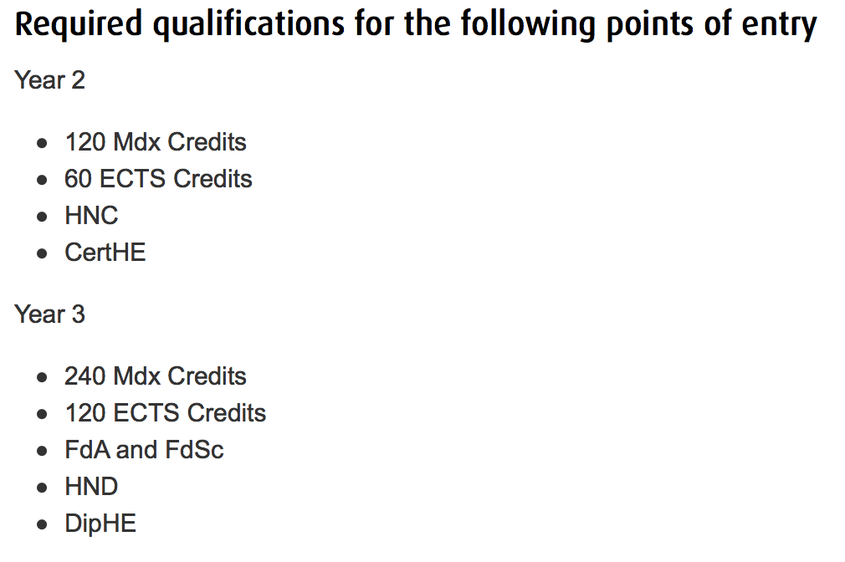
Credit system used at the institution

Slide 4
Alignment (or lack of) with the Bologna Process

Slide 5
Use (or lack of) ECTS

Slide 6
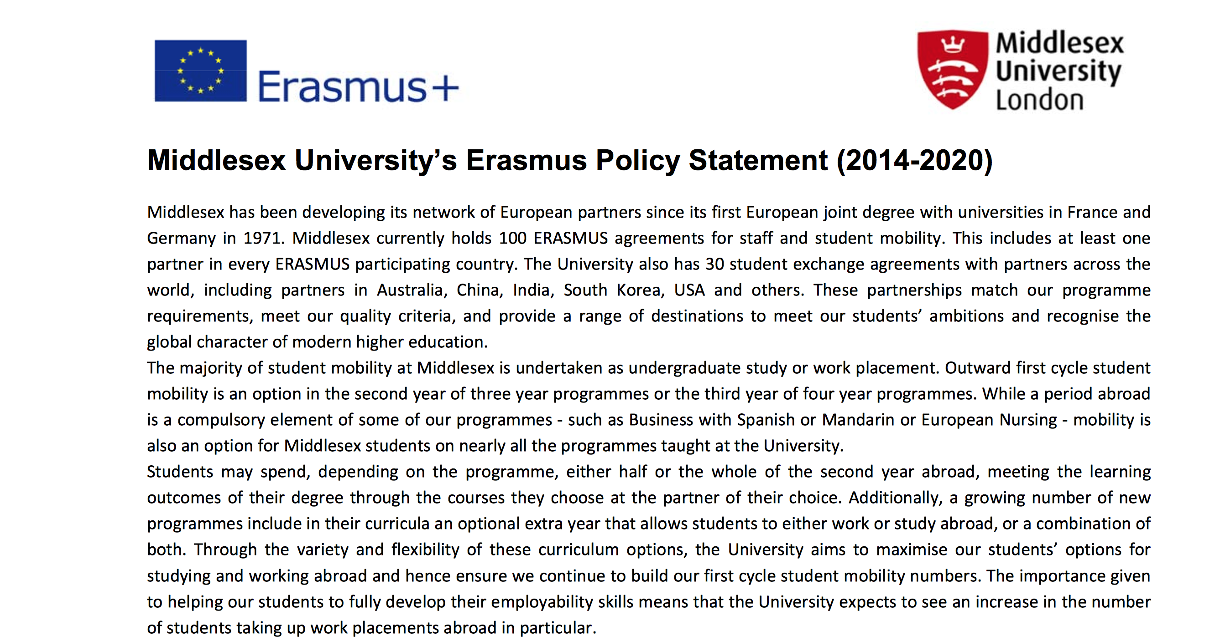
Administration structure supporting student mobility

Slide 7
Student mobility process
Identify possible destinations
Discussions with academic team
Administration support from exchanges team
Credit transfer
Grade conversion

Slide 8
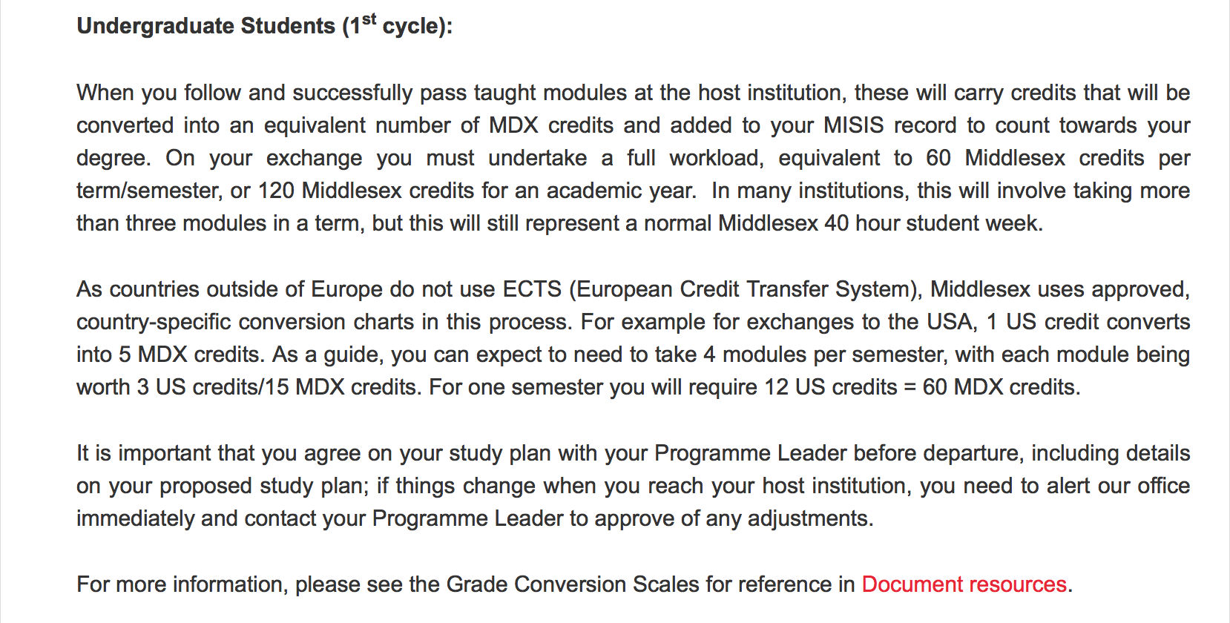
Credit transfer process

Slide 9
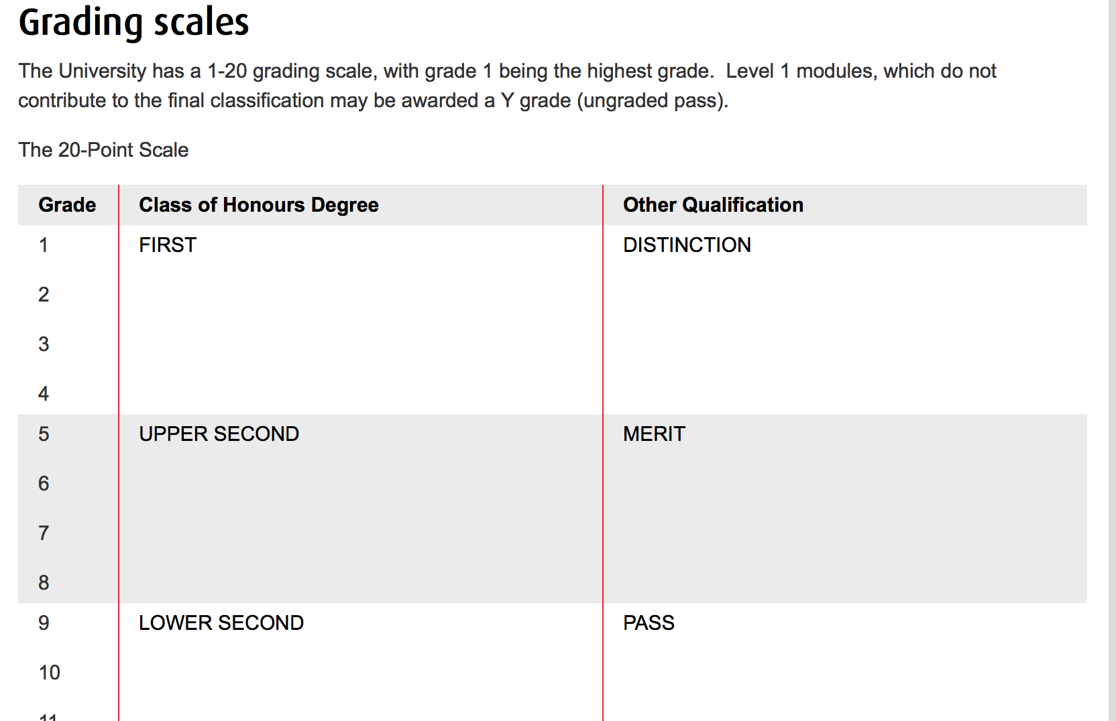
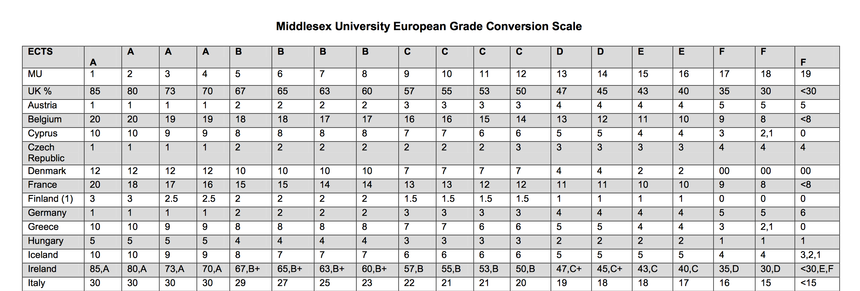
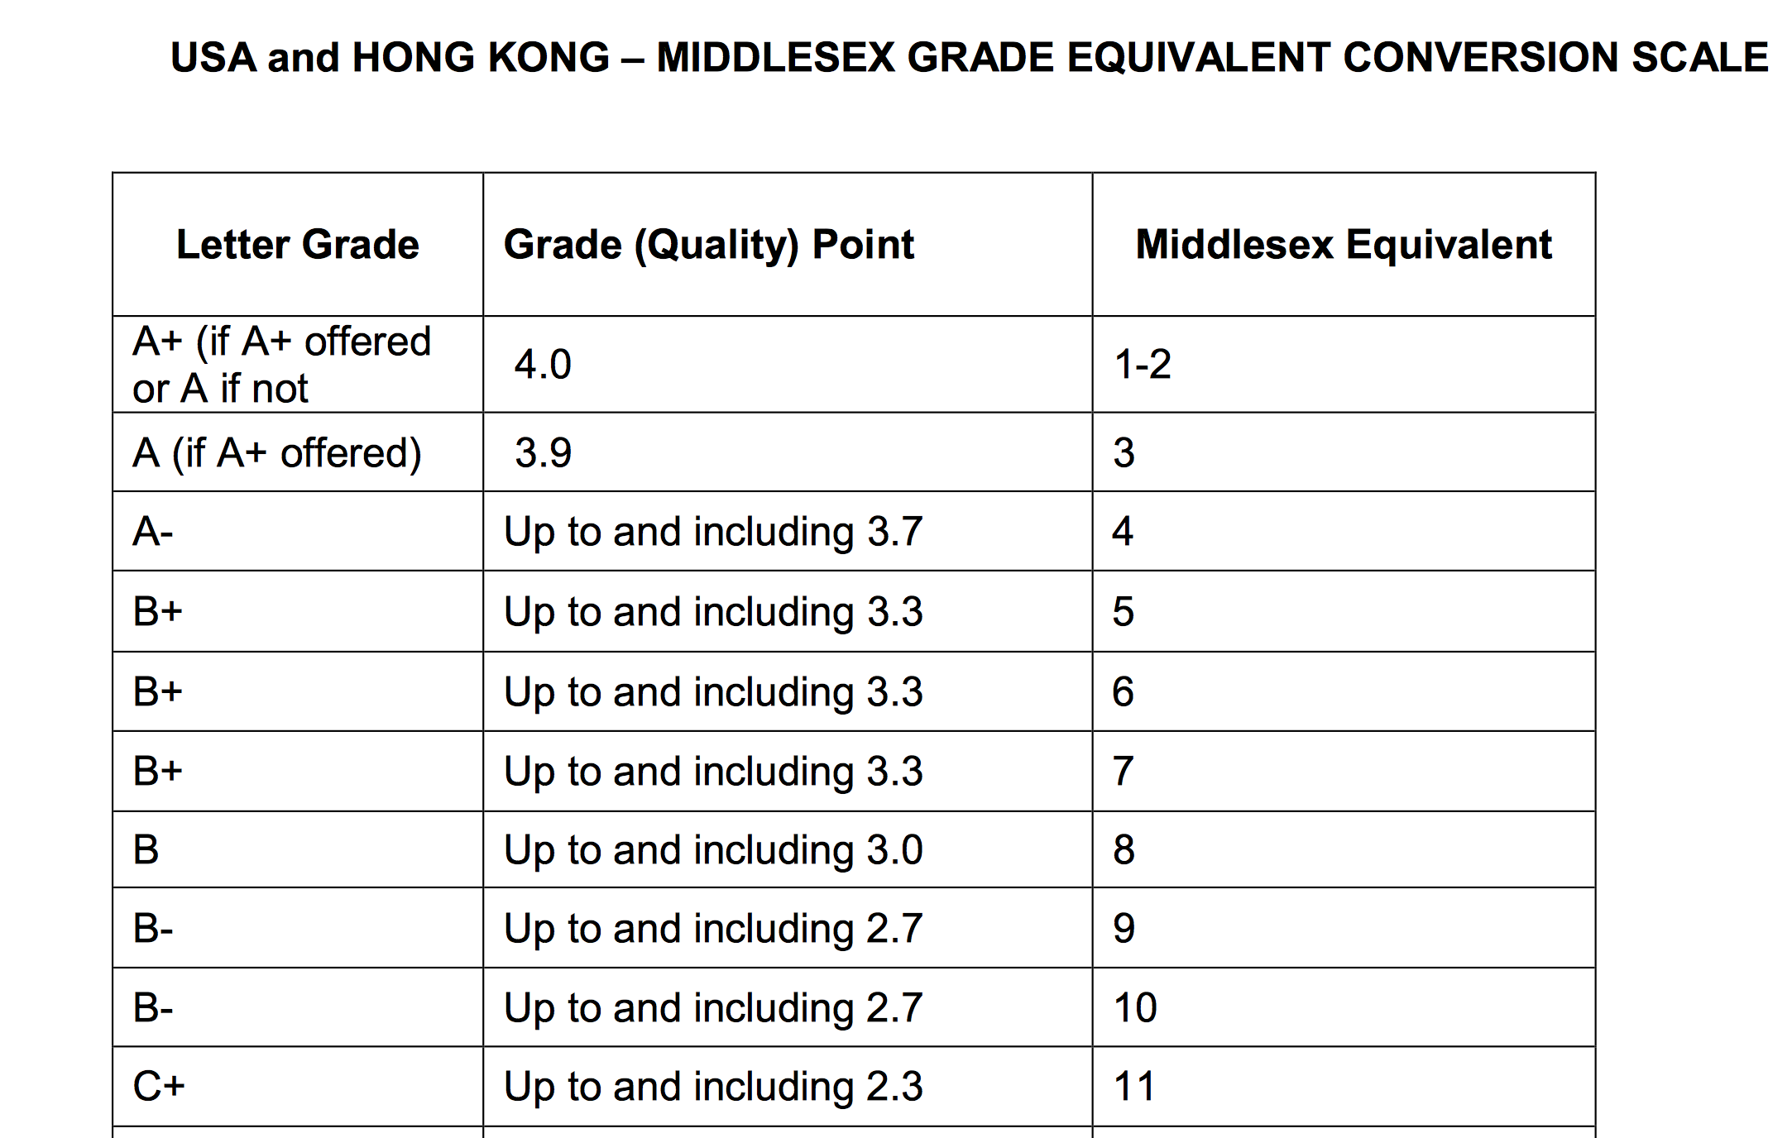
Grade conversion process

